Slide 1
Tutorial 10
Statistical Computation and Analysis
Spring 2025

Slide 2
Tutorial Outline
Bambi
Polynomial Regression & Splines

Slide 3
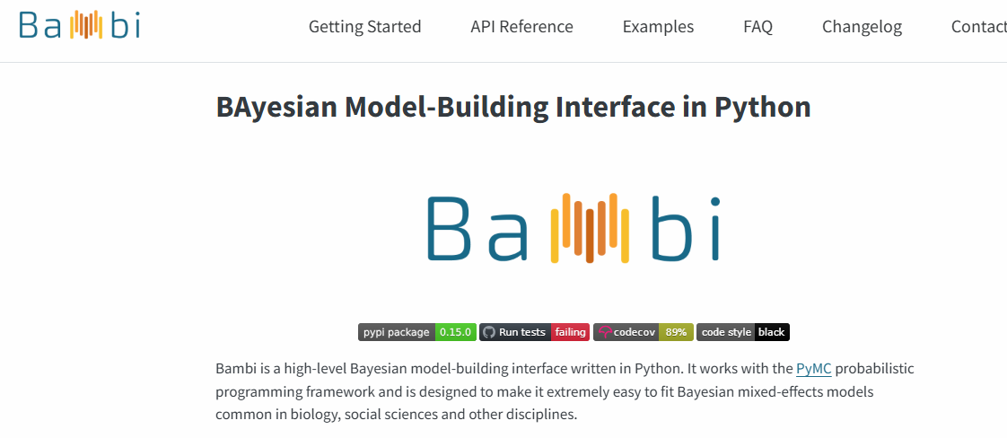
Bambi
https://bambinos.github.io/bambi/

Slide 4
Bambi
A high-level Bayesian model-building interface written on top of PyMC.
Designed to make it extremely easy to fit linear models, including hierarchical one.

Slide 5
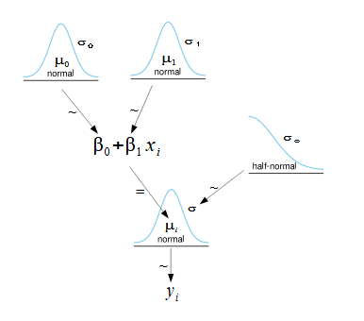
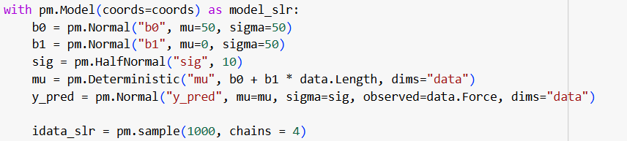

PyMC vs. Bambi
What we did until now:
With Bambi: (import bambi as bmb)
The dependent variable is on the left and the independent on the right.

Slide 6

Bambi
What is bambi doing?
Print the model
Bambi assumes the likelihood is gaussian (this can be changed).
We only specified how the dependent and independent variables are related.
Bambi automatically defines weakly informative priors.

Slide 7
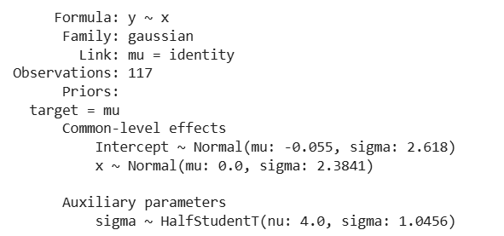
Bambi
Relationship between dependent and independent variables
Likelihood
Corresponding link function
Dataset size
Linearly modelling the parameter mu of the Gaussian
Common level effects
Model Structure
Not linearly modeled parameters

Slide 8
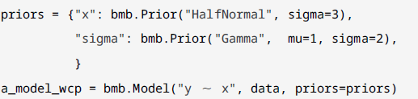
Bambi
If we would like to set our own priors:
For example, for:
The coefficient of the independent variable (the slope)
And for sigma (the auxiliary parameter)
Define a dictionary and pass it to the model

Slide 9
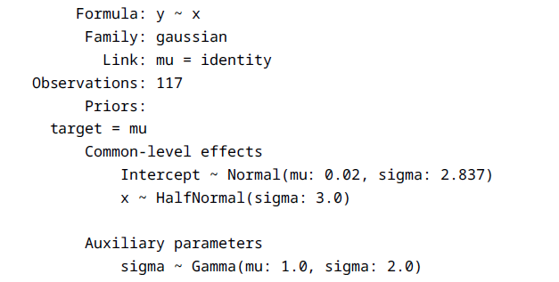
Bambi
If we print the model:

Slide 10
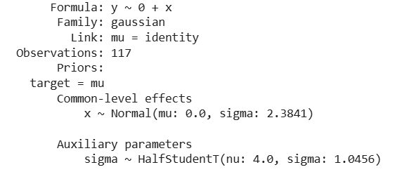
Bambi
We can also omit the intercept from the model in two ways:
No intercept

Slide 11
Bambi
Multiple regression in Bambi:
Bambi also allows for modelling linear hierarchical regression.

Slide 12
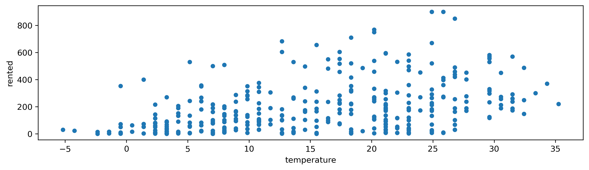
Bambi – The Bikes Example
In a previous lecture, you examined the relation between the number of bikes rented and the temperature.
You compared linear regression with the generalized linear model using the negative binomial distribution.

Slide 13
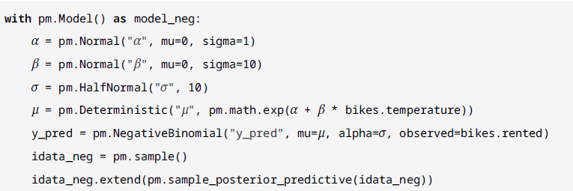
Bambi – The Bikes Example
Model in PyMC:
Model in Bambi:

Slide 14
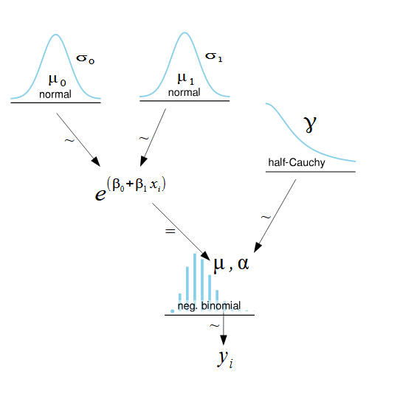
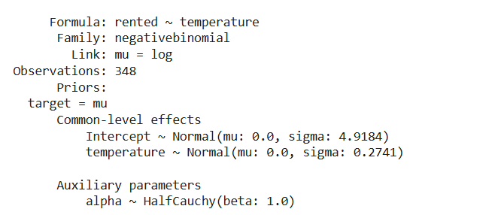
Bambi – The Bikes Example
Print the model and draw it:

Slide 15
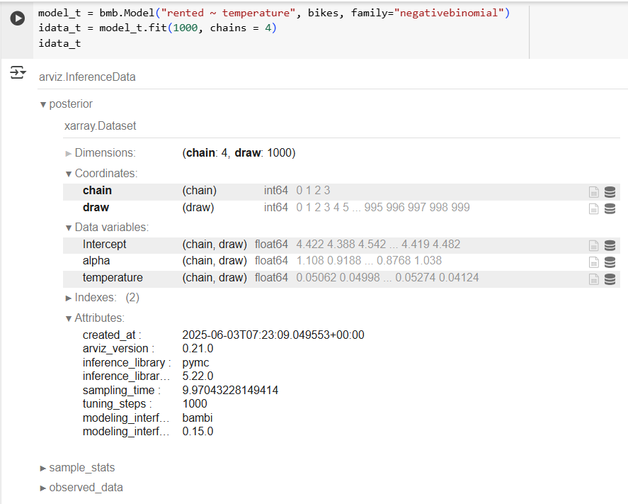
Bambi – The Bikes Example
Using the fit function returns an inference data object containing xarray datasets.

Slide 16
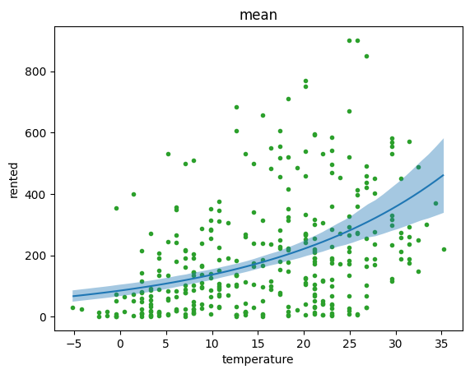

Bambi – The Bikes Example
We can also use bambi functions to look at the posterior.
Look at the posterior mean and 94% HDI.
Only accounts for the uncertainty in the intercept and slope parameters.

Slide 17
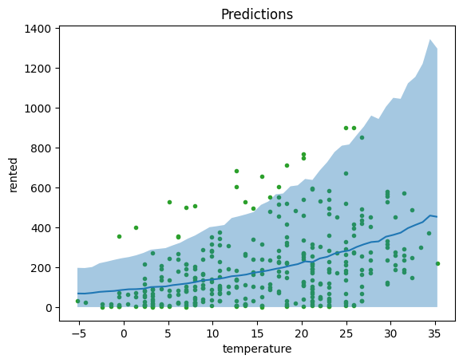
Bambi – The Bikes Example
Posterior predictive distribution.
Accounts for the uncertainty in the model parameters and the data.
Notes:
Function API - https://bambinos.github.io/bambi/api/interpret.plot_predictions.html

Slide 18
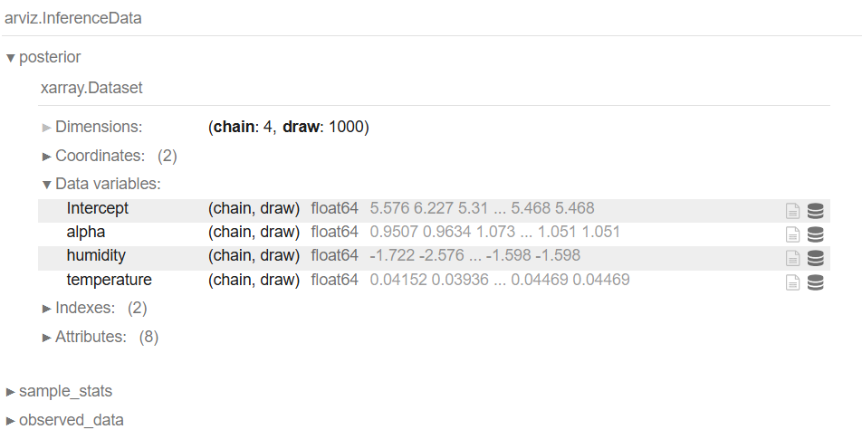
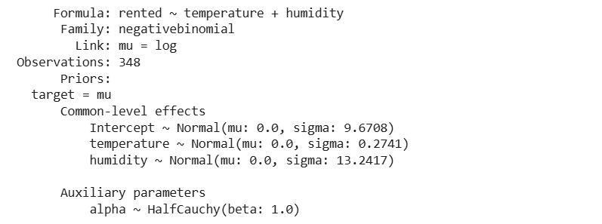
Bambi – Multiple Regression (Bikes Example)
Use both the temperate and the humidity as independent variables.

Slide 19
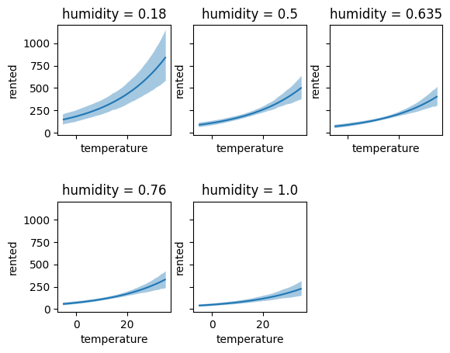
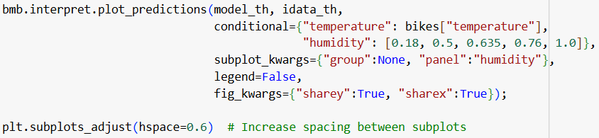
Bambi – Multiple Regression (Bikes Example)
We can look at the mean posterior for different humidity levels.
The number of rented bikes increases with temperature, but the slope is larger when humidity is low.
Notes:
Conditional - The covariates we would like to condition on. If dict, keys are the covariate names and values are the values to condition on.
subplot_kwargs - Keyword arguments used to determine the covariates used for the horizontal, group, and panel axes. For example, subplot_kwargs=dict(main="x", group="y", panel="z") would plot the horizontal axis as x, the color (hue) as y, and the panel axis as z.
fig_kwargs - Keyword arguments passed to the matplotlib figure function as a dict. For example, fig_kwargs=dict(figsize=(11, 8)), sharey=True would make the figure 11 inches wide by 8 inches high and would share the y-axis values.
https://bambinos.github.io/bambi/api/interpret.plot_predictions.html

Slide 20
Polynomial Regression & Splines

Slide 21
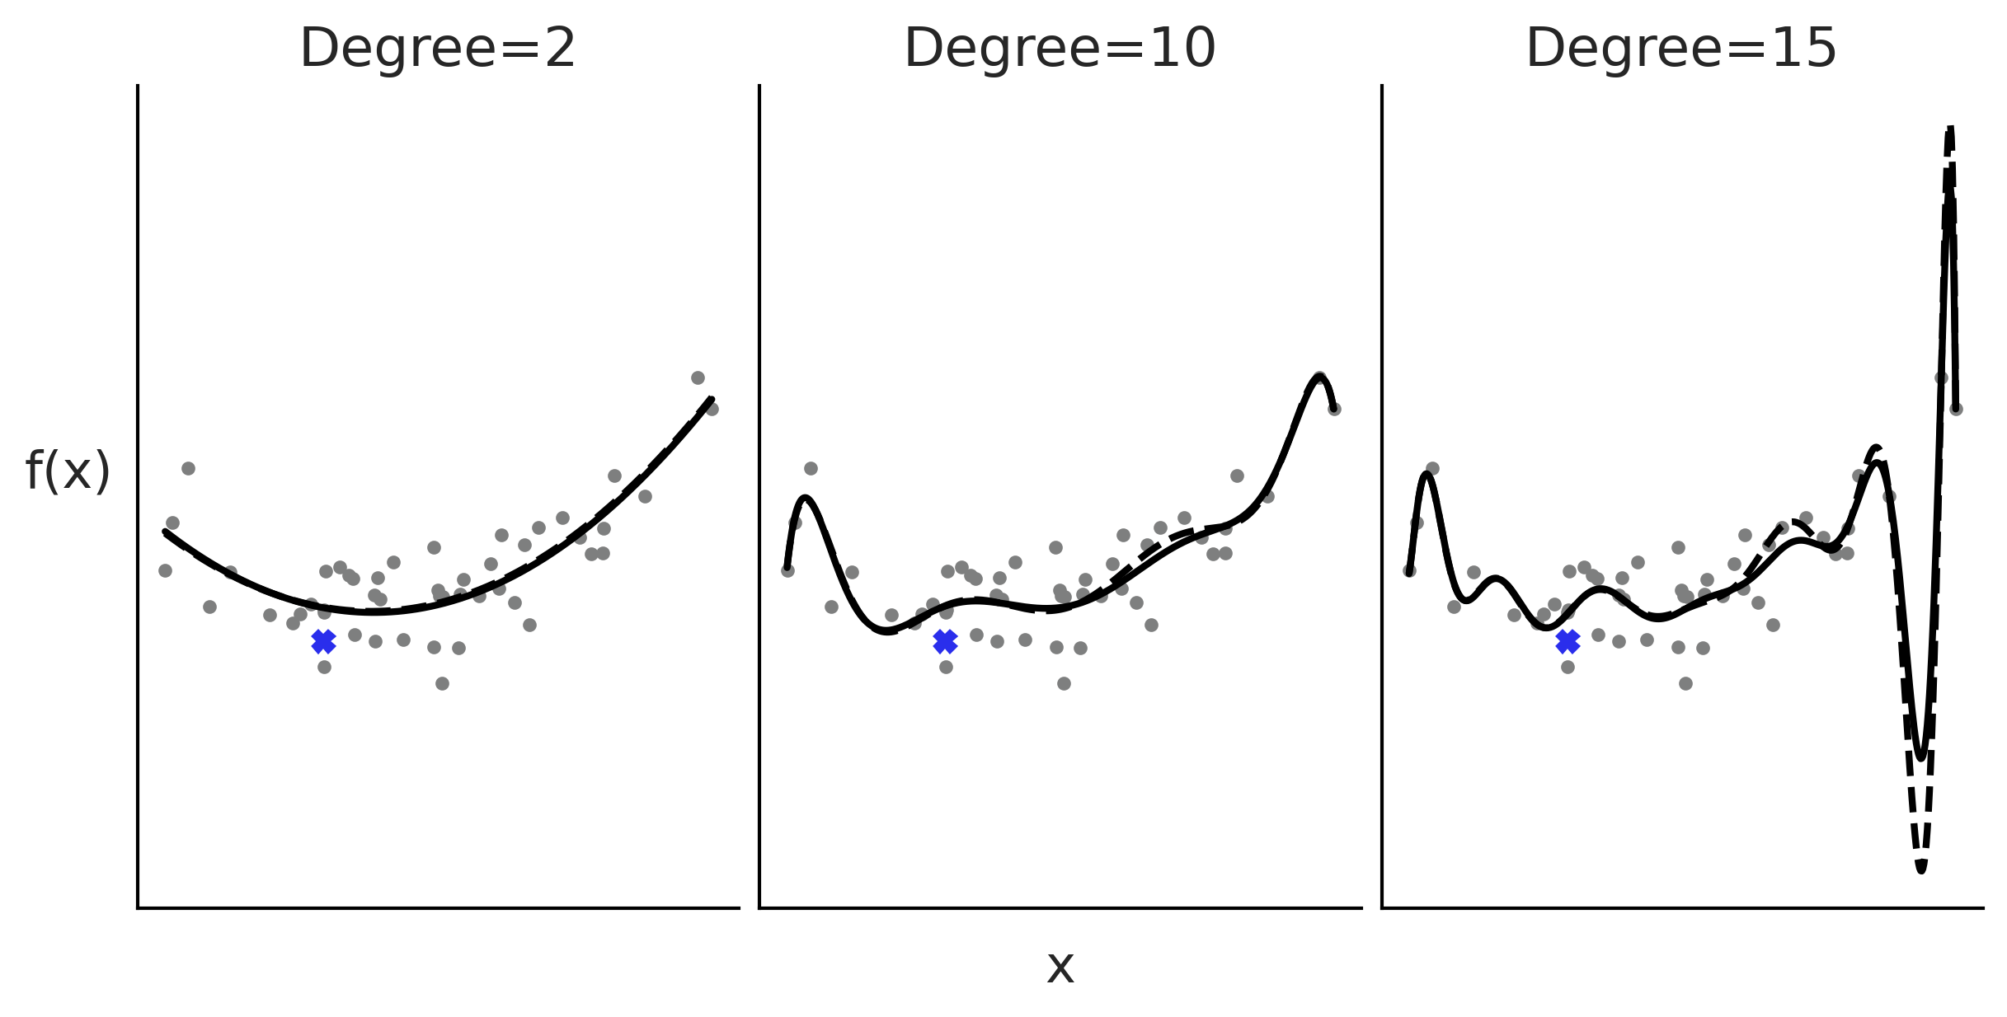

Polynomial Regression
$μ=β_{0}+β_{1}x+β_{2}x^{2}+β_{3}x^{3}+…$
The higher the degree of the polynomial, the more flexible the curve can be.

Slide 22

Polynomial Regression
There are two ways to define in Bambi:
where I is the identity function.
Notes:
** are operators in bambi, to create a function you need to add I().

Slide 23
Polynomial Regression
The two definitions should lead to the same predictions but are not actually the same.
Using the poly syntax (poly(x, 4)) ensures that the polynomial terms will be orthogonal to each other.
Can be numerically more stable.
Orthogonal polynomials allow you to interpret the effect of each term more clearly, as they are independent of each other.

Slide 24
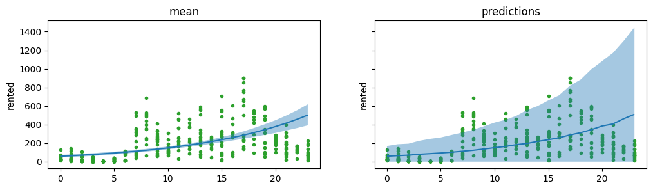
Polynomial Regression – Bikes Example
Model the number of bikes rented on the hour of the day.
Let’s start with simple regression (only as a function of hour).

Slide 25
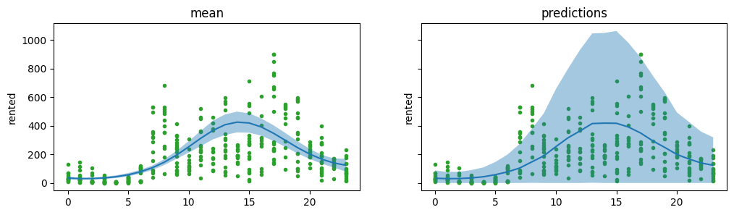
Polynomial Regression – Bikes Example
Polynomial regression with orthogonal fourth-degree polynomial.

Slide 26

Polynomial Regression – Bikes Example
Polynomial regression with standard fourth-degree polynomial.

Slide 27
Polynomial Regression – Bikes Example
When we apply a polynomial of degree 𝑚, we are saying that the relationship between the independent and dependent variables is of degree 𝑚 for the entire dataset.
As the number of degrees of freedom increases, the model becomes more prone to overfitting.

Slide 28

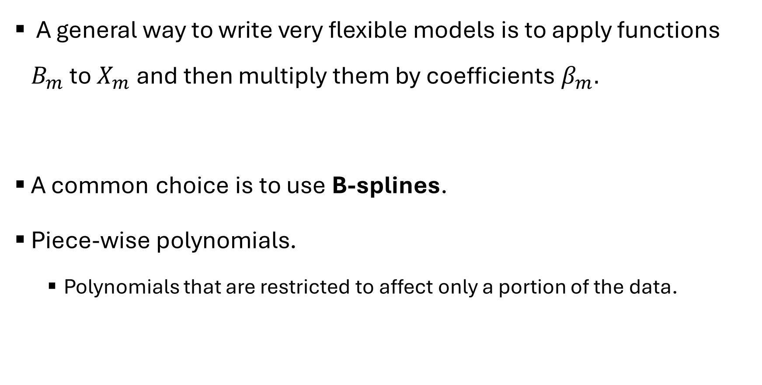
Splines
A general way to write very flexible models is to apply functions $B_{m}$ to $X_{m}$ and then multiply them by coefficients $β_{m}.$
A common choice is to use B-splines.
Piece-wise polynomials.
Polynomials that are restricted to affect only a portion of the data.
Notes:
Splines - piecewise polynomials with continuity constraints
Instead of one global polynomial of degree m, we break the domain of x into smaller intervals and fit a low-degree polynomial on each interval.
We then “stitch” those polynomials together at special points called knots, enforcing continuity (and often continuity of derivatives) at each knot.
The result is a single “smooth” curve that can bend to follow complicated shapes—yet each local bend is controlled by only a few parameters.

Slide 29
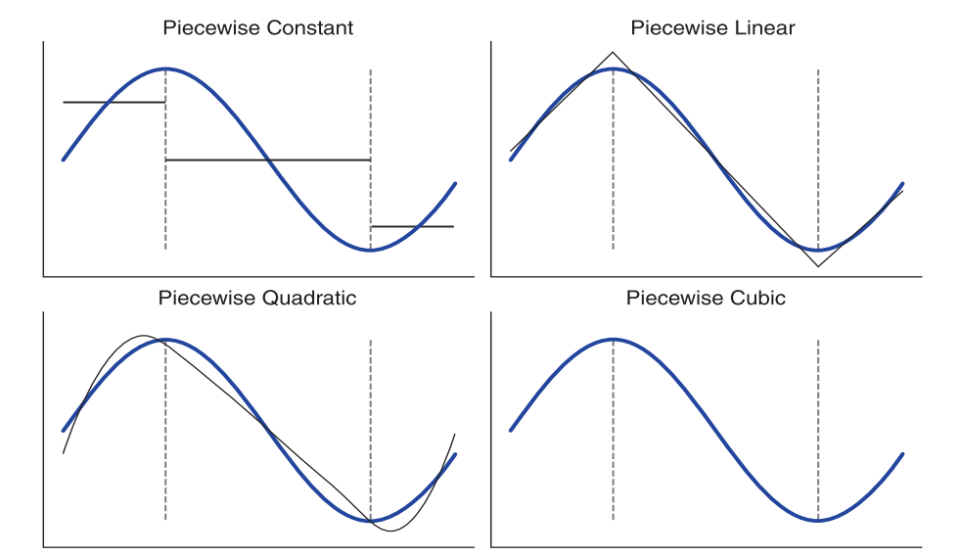
Splines
Let’s say we are approximate the blue curve.
The black lines show the fit according to the degree of the polynomial.
The dashed black lines show the knots - the points used to restrict the regions.

Slide 30
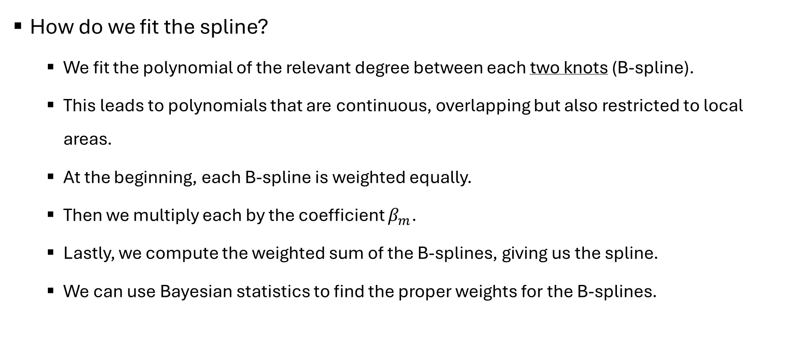
Splines
How do we fit the spline?
We fit the polynomial of the relevant degree between each two knots (B-spline).
This leads to polynomials that are continuous, overlapping but also restricted to local areas.
At the beginning, each B-spline is weighted equally.
Then we multiply each by the coefficient $β_{m}$.
Lastly, we compute the weighted sum of the B-splines, giving us the spline.
We can use Bayesian statistics to find the proper weights for the B-splines.

Slide 31
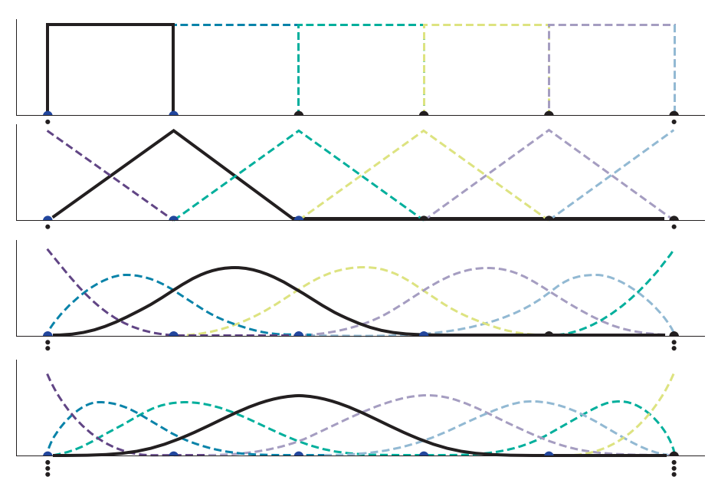
Splines
The B-splines.
0 degree spline
(6 knots)
1 degree spline
In a spline of degree n:
The bases a polynomials of degree n
n+1 bases overlap between knots
n bases overlap at each knot
2 degree spline
3 degree spline
Notes:
What you see:
Four horizontal panels, each labeled “0 degree spline,” “1 degree spline,” “2 degree spline,” and “3 degree spline.”
On the x-axis of each panel are a sequence of black dots (these are the knots). Above them, each colored dash‐line is a single B-spline basis function of that degree. A solid black outline (in each panel) highlights one of the basis functions so you can focus on its shape.
Goal:
Show exactly how each basis function looks (not yet the weighted sum).
Emphasize the changing support and continuity properties as degree goes from 0 → 3.

Slide 32
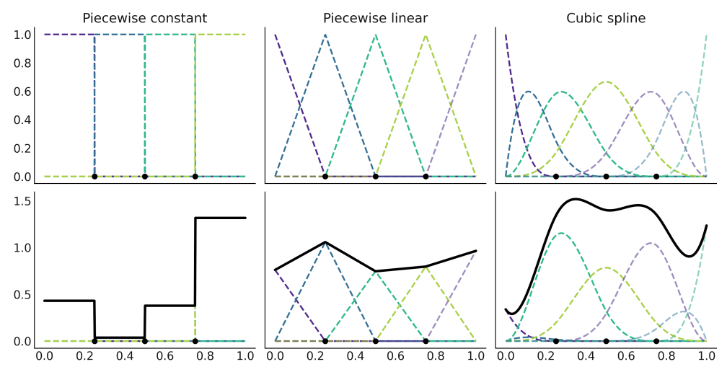
Splines
The spline
Notes:
A “spline” is simply a collection of low-degree polynomials, each living on its own subinterval, but “glued” together so that the overall curve is smooth.
The top row of each column shows the individual basis functions (dashed colored lines) that we can combine (with weights) to build a final fit.
The bottom row of each column shows the resulting fit (solid black curve) when you pick some arbitrary weights for those basis functions and sum them up.
Comparing columns of degree 0, degree 1, and degree 3 (cubic) will demonstrate how higher degree gives more continuity in derivatives.

Slide 33
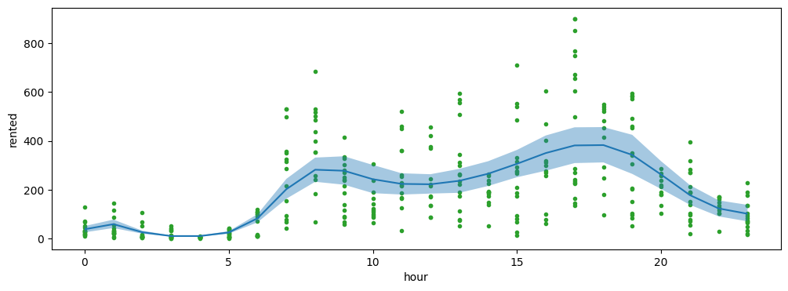
Splines – Bike Example
Using Bambi to fit a spline to the bike data:
This yields:

Slide 34
Splines – Bike Example
We can see that the number of rental bikes is at the lowest number late at night.
There is then an increase, probably as people wake up and go to work or school, or do other activities.
We have a first peak at around hour 8, then a slight decline, followed by the second peak at around hour 18, probably because people commute back home, after which there is a steady decline.

Slide 35
Splines – Bike Example
How should we choose where to place the knots?
We can choose based on quantiles rather than uniformly.
This positions more knots in areas where we have a greater amount of data, while placing fewer knots in areas with less data.

